Slide 1
Wavelength calibration
Find the centroid for each lenslet, each discrete wavelength
Use 3rd order, 2D polynomial fit in both X and Y
Interpolate polynomial coefficients to map arbitrary wavelengths
Compute the wavelength at the centers of each pixel in each microspectrum
If enough SNR, compute PSFLet templates over a small number of regions of the detector
Compute lenslet illumination ”flat”

Slide 2
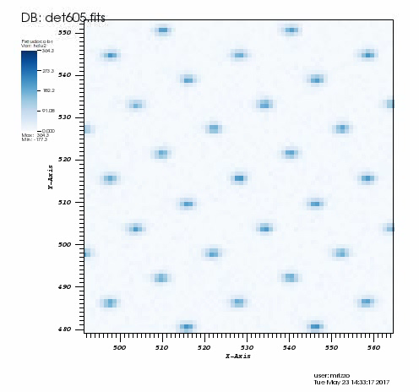
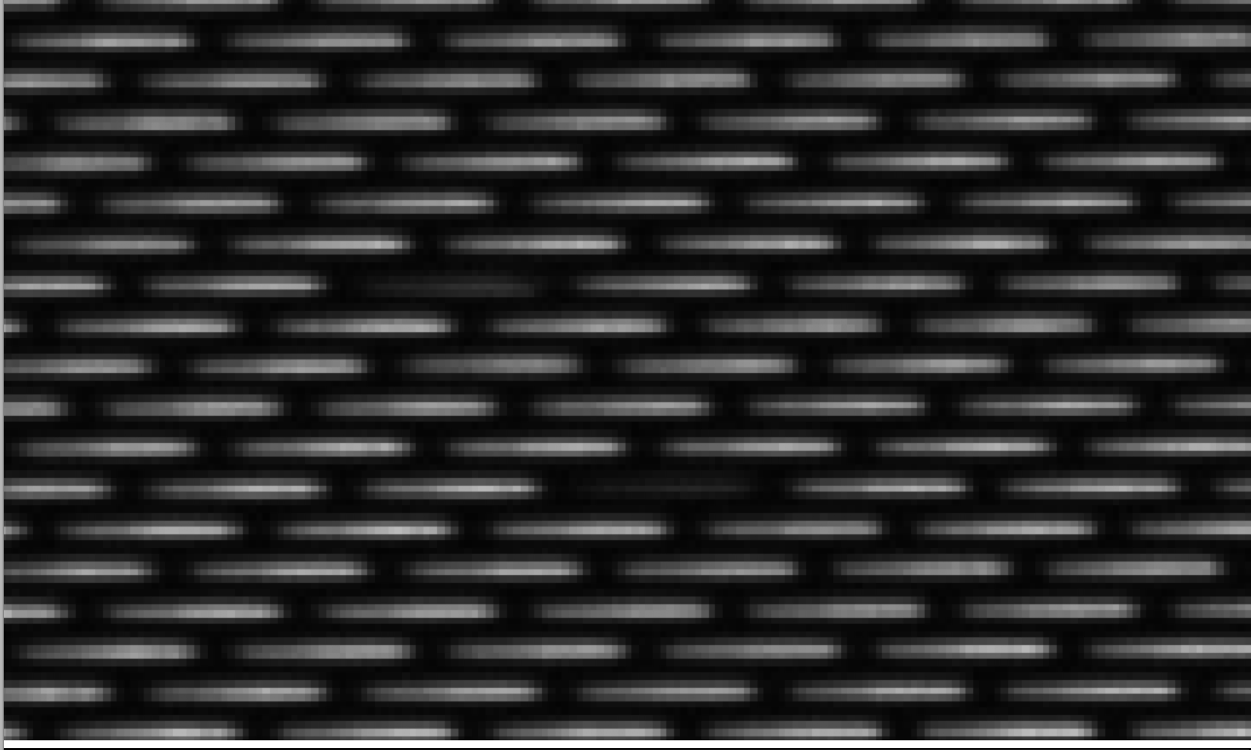

Slide 3
Optimal extraction
For each pixel of a microspectrum, fit a 1D matched filter in the cross-spectral dimension
Each microspectrum now has ~22 flux measurements for its own set of 22 wavelengths, the ones that correspond to the pixel centers for that particular microspectrum
Interpolate these fluxes and remap them onto a common wavelength grid
Now all microspectra have the same wavelength grid, the results can be shown in a cube
Pros: fast, requires minimal calibration, tolerant to small errors in PSFlet width, appears sufficient for wavefront control
Cons: spectral cross-correlation, does not account for true PSFlet shape, lower SNR

Slide 4


Slide 5
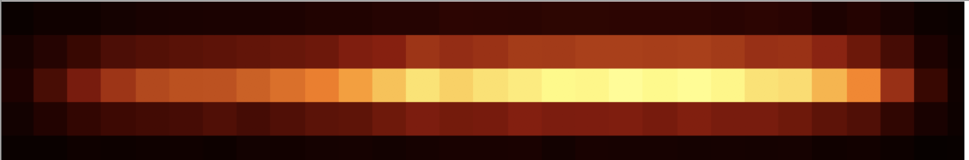
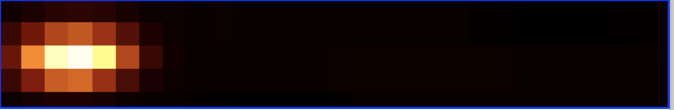
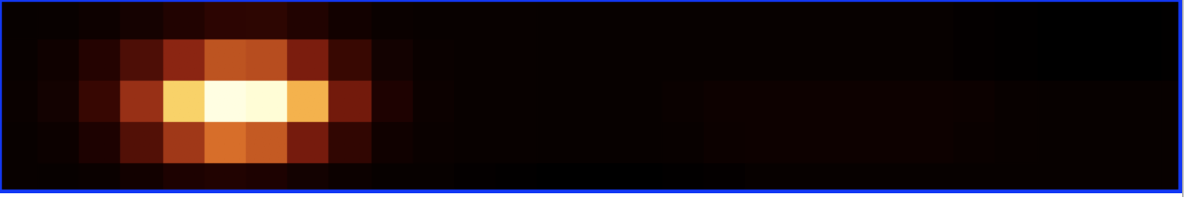









Microspectrum:
2D PSFlet models
digitized according
to wavelength calibration:
Extracted spectrum is the coefficients for the model PSFLets

Slide 6
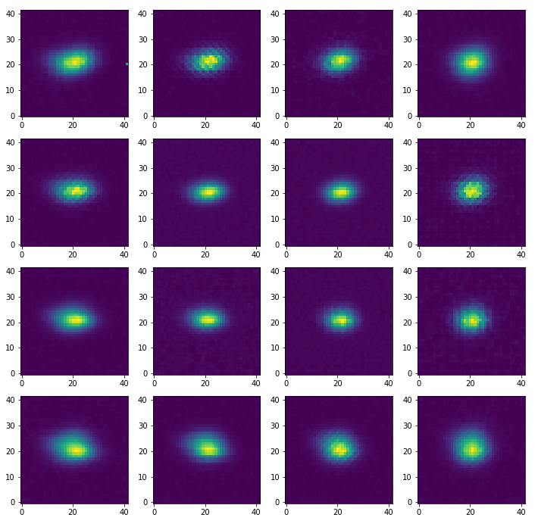
Least squares extraction
Top right
of detector
Fit each micro-spectrum as a sum of 2D PSFLet templates
Pros: fit the instrument line function; best SNR properties, no spectral cross-correlation
Cons: Requires high-resolution PSFlets across the entire detector (needing high SNR, low aberrations for sufficient sampling diversity)
Bottom left
of detector

